Slide 1

I-Focus
Group 10-11 Samuel Leong 4S1(17)
Ryan Tan 4S1(21)
Walter Kong 4O3(33)
Xiao Songyuan 4S2(20)
Notes:
Good morning judges and fellow students.
Be prepared to be amazed by the project that we have been working on for the past 4 months.. I-Focus

Slide 2
Introduction
Notes:
I-Focus could revolutionise the way we interact with our devices.

Slide 3
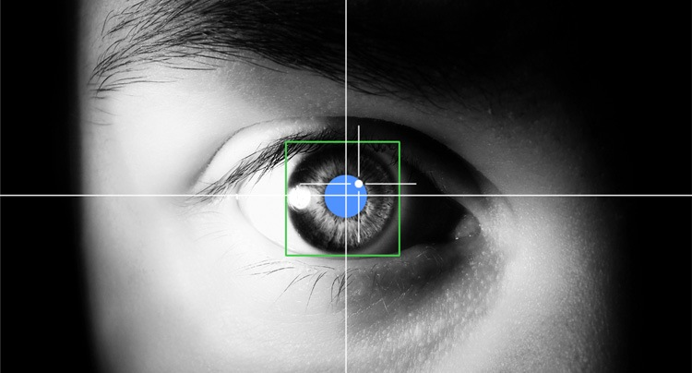
EFFICIENT.
Effective.
INTUITIVE.
Eye-tracking: Look at where you want the cursor to move.
Multi-modal Input: Eye-tracking + Clicks + Head gestures

Slide 4


Objectives
DSO

Slide 5

Target Audience
Physically Disabled
General Public

Slide 6

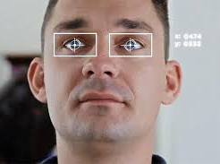
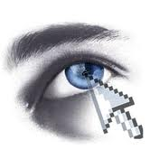

Why I-Focus?
Notes:
[shorten if possible]
So this leads us to answer the question – why I-Focus? Why do we need a revamp in the current forms of mouse and even touchscreen inputs for able-bodied people?
…
3 words: efficiency, effectiveness and intuitiveness
The one-size-fits-all model of kinesthetic input which we get from the mouse is simply inefficient and unintuitive. We use the mouse for everything – clicking, moving, dragging.. And the only reason why we find the mouse pretty effective and efficient is because we have been using it for a long time. [projector screen example] With eye-tracking, everything is fast, efficient and convenient. Just look at where you want to move and click. Look at a link, click on it. Look at an icon, open the application. Efficient. Effective. Intuitive.

Slide 7
Methodology

Slide 8
Methodology
Application
Research
Improvements

Slide 9

Timeline
Prelim Presentation
Semis Presentation
Finals Presentation
Prelim
Semis
Finals
Planning
Developmental
Implementation
Alpha Testing
Beta Testing
Extensions
Notes:
"So, this was our proposed timeline and we are pleased to say we have completed the alpha testing (our research) earlier than expected…
Now, ready to see what we have done so far?

Slide 10
Application
Notes:
…presenting to you the application component of I-Focus

Slide 11


The Applications
Notes:
Our final products will demonstrate the efficiency of eye tracking on websites, and simple games.

Slide 12
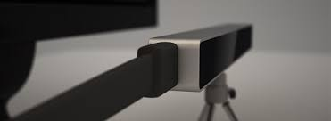
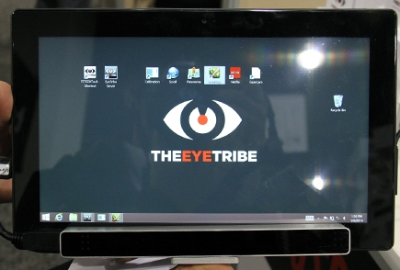
Devices
EyeTribe Eye-Tracker
Affordable
Accurate
Notes:
The device we would be using is the EyeTribe eye-tracker, which is affordable and a lot more accurate than webcams.

Slide 13
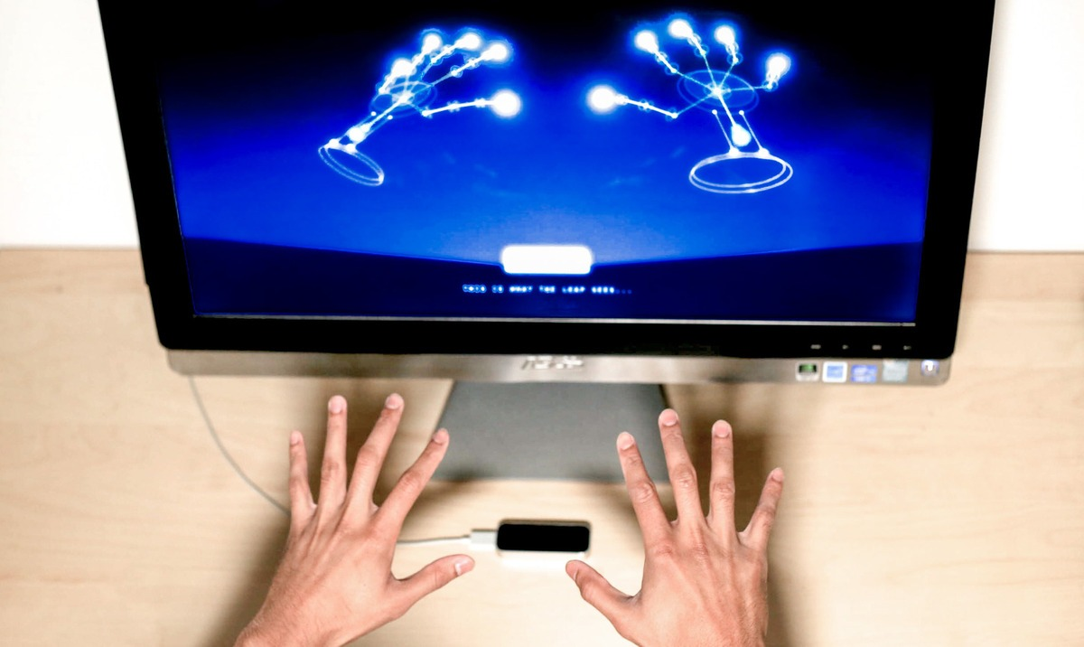
Devices
Leap Motion
Physical Input
Hand Gestures
Notes:
The leap motion device is a device that tracks hand gestures and is used to sense physical input.

Slide 14

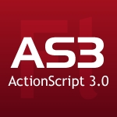


Programming Languages
HTML 5
CSS 3
JavaScript
#
Notes:
Breeze thru

Slide 15
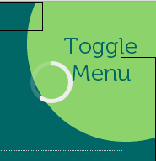
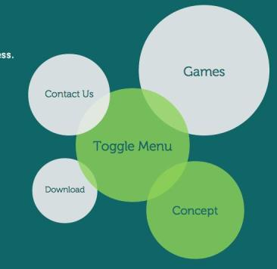
Features
Auto-scrolling
Modified Cursor
Video Control
Radial Menu

Slide 16
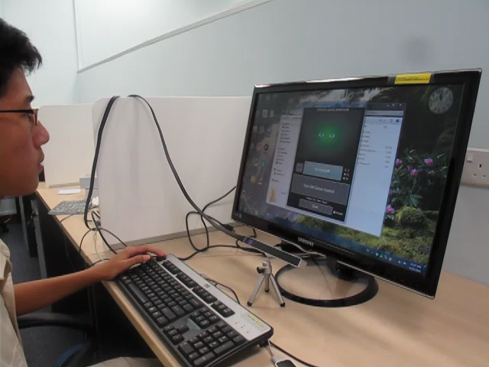
Calibration

Slide 17
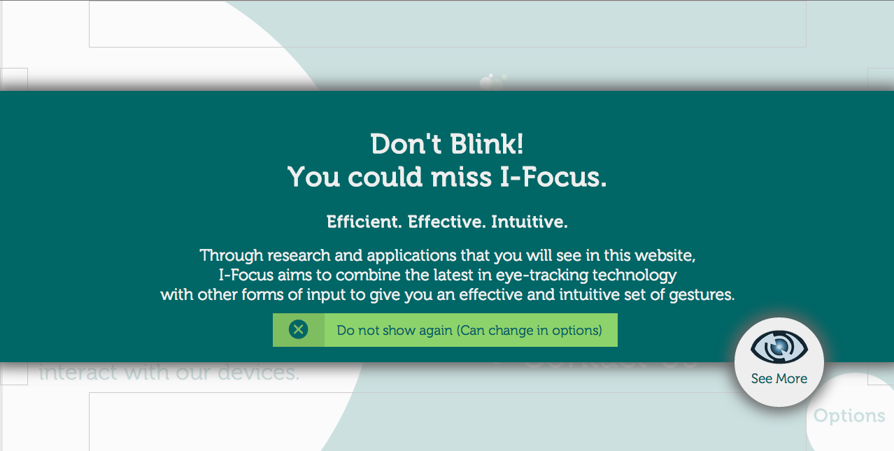
Screenshots

Slide 18
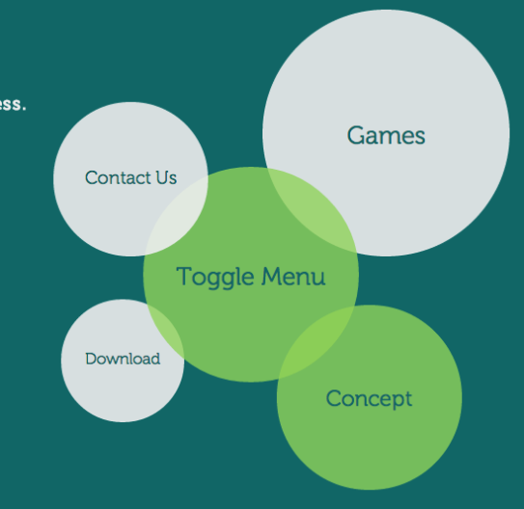
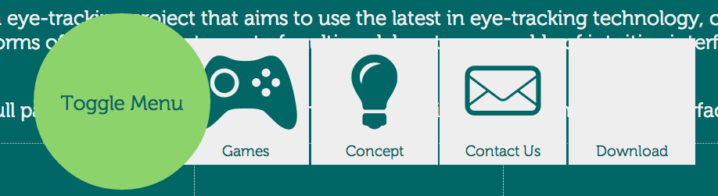
Screenshots
Notes:
Briefly talk about reason for having tabbed vs radial menu
Size difference
Speed
Left-to-right reading

Slide 19
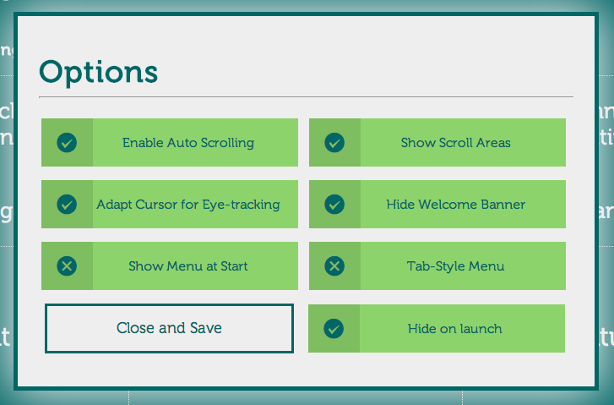
Screenshots

Slide 20

Screenshots

Slide 21

The Full Package
Research
Gestures
Console App
Website
Games
Notes:
Gestures => Console App (bridge) => Website & Games => Backed up by Research.

Slide 22

Live Demo
Efficient.
Effective.
Intuitive.
Notes:
Game (comparison)
Eye-tracking
Mouse
Website (features – for a purely hands-free interface for disabled)
Menu
Modified cursor
Auto-scroll
Video function
Other features
Dasher?
Typing program for disabled

Slide 23
Research

Slide 24
Video
Notes:
[Video]

Slide 25
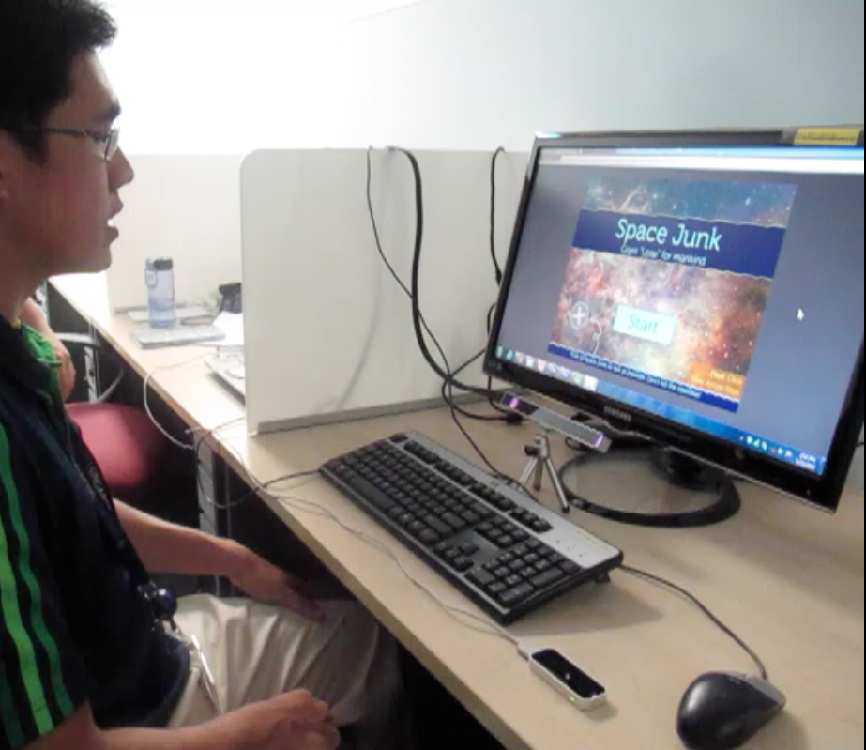
Research Setup
Participant
Big Screen
Eye-Tracker
Fixated Mouse
Leap Motion
Notes:
[Setup]

Slide 26
Research Procedure
6 Live Participants
Game
Website
Notes:
We conducted the experiment on 6 live participants, all of whom were randomly chosen. Each participant was required to play a game and navigate through our website.

Slide 27
Research Procedure
Game
Website
Quantitative (Timing) + Qualitative (Survey) Data
Test suitability of input methods for tracking tasks
Eye-Tracker
Mouse
Leap Motion
Notes:
The game was played 3 times by each participant, each time having a different input method, namely eye-tracker, mouse, and leap motion. The objective was to test the suitability of input methods for tracking tasks, and for that, we recorded the timing participants needed to complete the game each time. We also asked them to rank the input methods according to preference.

Slide 28


Results - Game
* Lower the timing, the better.
Notes:
The game actually required participants to find 10 targets in the shortest time, so the lower the score, the better. Leap motion timings were off the charts, and all 6 participants ranked leap motion last. Clearly, we’ve concluded that leap motion is out of the picture. Although the fastest input method was still the mouse, which on average took 5.7 seconds less than eye-tracking, half the participants still ranked eye-tracking to be 1st, while the other half chose the mouse, as can be seen from the icons at the top. Why is this so?

Slide 29
Comments - Game
Eye-Tracking
“if accurate, it is… as good (1) or better (4) than a mouse”
“It’s is pretty intuitive”
Like that they “literally get what they see”
“Quite jittery, but very fast”
Should try sound input as a selection method… It’s more intuitve
Notes:
Participants’ general comments and feedback gave us insights to why they are accepting of eye-tracking despite the lousier statistics. Turns out, accuracy was the main problem. Our commercial standard eye-tracker didn’t have very good accuracy. 1 participant felt that if the eye tracker had pinpoint accuracy, it would be as good as the mouse and keyboard, while 4 participants felt that eye-tracking would be even better. Participants generally felt that it was pretty intuitive, and liked that they literally get what they see. Some complained of jitter, but was impressed by the speed that the eye-tracking input method could offer. Others suggested sound input as a selection method.

Slide 30
Comments - Game
Pure Leap Motion
Not good
“Too tiring”
“Prone to errors”
Gestures unresponsive
Accidental clicks
Notes:
Pure leap motion wasn’t at all well-received due to the fact that constant gesturing was too tiring and too prone to errors. Participants felt that it wasn’t good.

Slide 31
Research Procedure
Game
Website
Questionnaire for User Interaction Satisfaction (QUIS)
Compare 2 versions of website (optimized vs not optimized)
Menu
Arrangement
Selection Method
Scrolling Method
Notes:
Each participant was also required to navigate through 2 versions of our website that differed in menu arrangement, selection method, and scrolling method. The first version had a radial menu, the modified cursor mentioned earlier, and auto scrolling. In the 2nd version, participants had a linear menu, used mouse clicks to select, and the mouse wheel to scroll. After navigating through each version, participants had to complete the Questionnaire for User Interaction Satisfaction, QUIS for short. The results of both QUIS tests were compared to determine the functions that gave a more efficient and intuitive interface.

Slide 32
Results - Website
* QUIS survey used. Higher the scores, the better.
Notes:
These are the results of the QUIS tests. The 2nd version, which is the one with kinesthetic clicks and no auto scrolling, had a higher mean than the 1st version. But the results suggest that each of the 2 versions were preferred by 3 participants, which is half of the sample size.

Slide 33
Results - Website
Overall Preference
Notes:
[Results; bar graphs, charts, tables]
[General comments and KEYWORDS (positive ones)]

Slide 34
Results - Website
Content
Most preferred radial menu as it was larger
5/6 participants preferred kinesthetic clicks
Modified cursor was considered more ineffective and too frustrating.
But, modified cursor scores were consistently above 5 (out of 9).
* QUIS survey used. Higher the scores, the better.
Notes:
Here are some of the general comments regarding the different features. Most preferred the radial menu as it was larger. This tells us that clickable area is a very important factor in the design of our website. 5 out of 6 participants preferred kinesthetic clicks as they felt that the modified cursor was too ineffective and too frustrating. However, our modified cursor still faired decently as it constantly scored a 5 out of 9 or higher.

Slide 35
Findings - Website
Video function should…
Be made an option
Have buffer time before auto-pausing
Reduce play timer
Cursor moving while reading is irritating
Cursor should disappear while over text
Radial Menu is better
Larger Area
Faster
Notes:
With the comments and feedback, we have decided to make changes to our website such as the ones listed on the screen.

Slide 36
Findings - Others
Calibration works better with lights on
Small eyes/Bad angle
More jitter and poorer accuracy
Larger Screen
Better Accuracy
Notes:
These are some of the other findings that are beyond our control.

Slide 37
Summary
Once eye-tracker is accurate enough,
Eye-tracking beats the mouse in terms of...
Speed/Efficiency
Targeting & Tracking tasks
Intuitiveness
Efficient.
Effective.
Intuitive.
Notes:
So in the culmination of our research, it is shown that once an affordable eye-tracker with sufficient accuracy surfaces in the market, eye-tracking will beat the mouse in terms of speed and efficiency especially for targeting and tracking tasks, and have improved overall intuitiveness. There you have it, efficient, effective, intuitive.

Slide 38
Looking to the Future...
Improving the Input Methods
Sound input over physical input
Improving Accuracy
Head tracking to mitigate precision
Improve Interface
Further Research
Suitability of certain tasks for eye-tracking

Slide 39
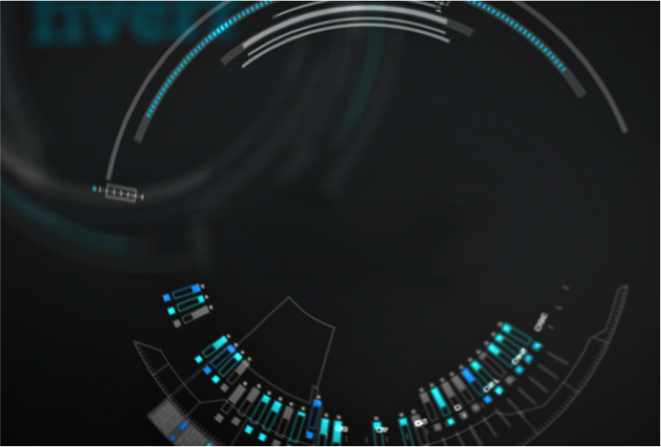
Thank You!
Notes:
“More than meets the eye”
“… in the blink of an eye”
“Look!”
“Don’t blink!”

